Slide 1
Date:
Presentation
TITLE: The anatomy of a large-scale hypertextual Web search engine
NAME(ID): Rishikesh Soni (2024H1030180H), Arijeet Rakshit (2024H1030183H), Sandeep Kanchan Pandit (2024H1030185H), Aaryan R Soni (2024H1030195H) Supervisor : Manik Gupta
Department of Computer Science and Information Systems

Slide 2
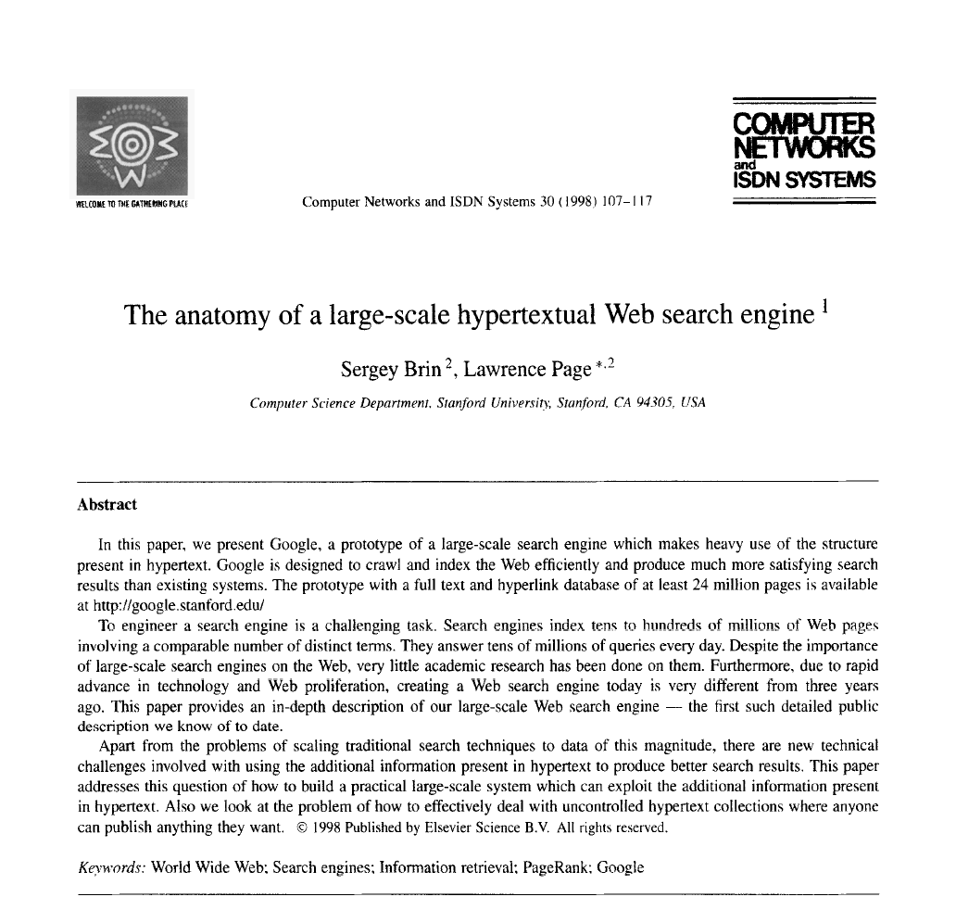
Paper

Slide 3
Introduction
Web Growth and Challenges
Rapidly increasing information and user base on the Web.
Users rely on:
Human-maintained indices (e.g., Yahoo!) - Expensive, subjective, slow to update.
Automated search engines - Often return too many irrelevant results.

Slide 4
Design Goals
High-Quality Search Results
Prioritize relevance over volume.
Address the problem of "junk results."
Scalability
Efficiently handle massive data from a growing Web.
Optimize storage and retrieval for speed and cost.

Slide 5
System Features
The Google search engine has two important features:
First, it makes use of the link structure of the Web to calculate a quality ranking for each Web page. This ranking is called PageRank.
Second, Google utilizes links to improve search results.

Slide 6
PageRank
What is PageRank?
A ranking algorithm that measures the importance of Web pages.
Based on the concept of academic citations:
Pages linked by many others are deemed more important.
Links from highly ranked pages have greater weight.

Slide 7
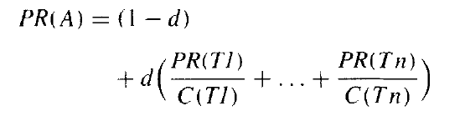
PageRank Formula
PR(A) = (1-d) + d * (PR(T1)/C(T1) + ... + PR(Tn)/C(Tn))
PR(A): PageRank of page A.
T1​,T2​,...,Tn​: Pages linking to A.
C(Tn​): Number of links from page Tn.
d: Damping factor (default: 0.85). Represents the probability that a user continues clicking on links.

Slide 8
PageRank Continued
Random Surfer Model
Imagines a user randomly surfing the web by clicking links.
The likelihood of landing on a page represents its PageRank.
High PageRank Factors
Quantity of Links: Many pages linking to a page increase its rank.
Quality of Links: Links from high-ranking pages significantly boost rank.

Slide 9
Advantages of PageRank
Quality of Results
Prioritizes pages that are deemed important by the web community.
Handling of Diverse Cases
Effectively ranks pages with many citations and those with few but significant citations.
Efficiency
Can compute PageRank for millions of pages quickly.

Slide 10
Anchor Text
Definition
The clickable text in a hyperlink.
Traditional Use
Search engines associate anchor text with the page containing the link.
Google's Approach
Also associates anchor text with the linked page.

Slide 11
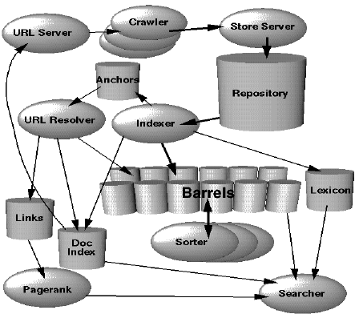
Google Architecture overview
Web Crawlers:
Multiple distributed crawlers work in parallel to download web pages.
The URLserver sends a list of URLs to be fetched to the crawlers.
Storage Server:
The crawled web pages are compressed and stored in a repository by the storage server.
Each page is assigned a unique identifier called a docID.

Slide 12
Continued
Indexer: The indexer reads the repository, decompresses the documents, and processes them. It converts each document into a set of word occurrences called "hits," which include details such as word position, approx. font size, and capitalization. The indexer also extracts all the links from each web page and stores important information about them in an anchors file.
Barrels: These hits are distributed into a set of barrels, creating a partially sorted forward index.
URL Resolver: This component processes the anchors file to convert relative URLs into absolute ones, associates anchor text with the docID of the target page, and generates a database of links which are pairs of docIDs. The links database is used to compute PageRanks for all the documents.

Slide 13
Continued
Sorter: The sorter reorders the barrels from being sorted by docID to being sorted by word ID, creating an inverted index. This involves minimal temporary storage and is done in place. The sorter also produces a list of word IDs and offsets into the inverted index.
Lexicon:A program called Dump Lexicon takes this list(a list of word IDs and offsets into the inverted index) together with the lexicon produced by the indexer and generates a new lexicon to be used by the searcher
Searcher: The searcher is run by a Web Server and uses the lexicon built by DumpLexicon together with the inverted index and the PageRanks to answer queries.

Slide 14
Crawling the Web
Web crawling is a key component of the search engine infrastructure, responsible for fetching web pages from the internet.
Process of Crawling
URL Server:
The central server provides a list of URLs to multiple crawlers.
It distributes tasks among crawlers to maximize efficiency.
Crawlers:
The agents that fetch web pages.
Each crawler manages 300+ simultaneous connections for efficiency.
They perform the following tasks:
DNS Lookups: Translate domain names to IP addresses.
HTTP Requests: Send requests to web servers for fetching pages.
Data Handling: Receive responses and store the web pages.
Data Storage:
Fetched pages are sent to the StoreServer, which compresses and stores them in the repository.
Pages are assigned unique identifiers called docIDs.

Slide 15
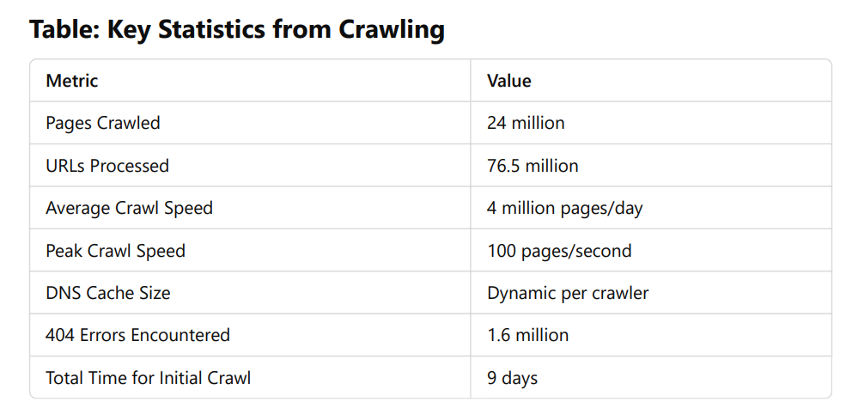
Cont…

Slide 16
Searching
The goal of the searching is to provide quality search results efficiently.
Workflow of Searching
Query Handling:
The searcher component receives user queries.
Queries are parsed and analyzed to identify relevant terms.
Lexicon and Inverted Index:
The searcher accesses the lexicon, which maps query terms to their locations in the inverted index.
The inverted index provides a list of document IDs (docIDs) where the terms occur, along with metadata such as position, font, and capitalization.
Ranking:
PageRank: Evaluates the importance of web pages based on their link structure.
Anchor Text: Uses link text as additional relevance signals.
Proximity Information: Prioritizes documents where query terms appear close to each other.
A combined ranking score is calculated for each document.
Merging Results:
For multi-term queries, doclists for each term are merged to identify documents that match all terms.
Doclists are sorted by relevance scores, and the top results are selected.
Displaying Results:
Results are presented to the user, including page titles, snippets (generated from anchor text or content), and URLs.

Slide 17
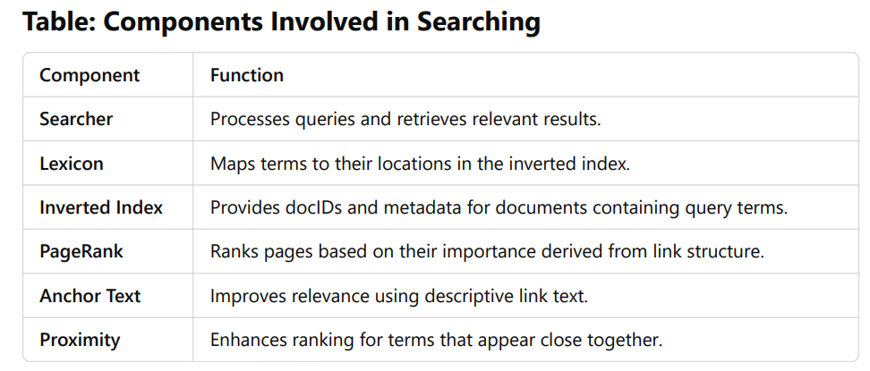
Cont…

Slide 18
Results and Performance
The most important measure of a search engine is the quality of its search results.
Performance Metrics
Crawling Speed:
Initial Crawl: 24 million web pages were fetched in 9 days.
Peak Performance: Up to 4 million pages/day or 100 pages/second using distributed crawlers.
Indexing Efficiency:
The indexer processes roughly 54 pages/second.
Sorting operations (parallelized across 4 machines) took 24 hours to complete for 24 million pages.
Search Query Speed:
Most queries were processed in 1–10 seconds.
Disk I/O and network file system (NFS) operations dominated response times.
Storage Optimization:
Efficient data structures allowed the prototype to handle:
108.7 GB of total data for 24 million pages.
Compressed repository reduced storage overhead significantly.

Slide 19
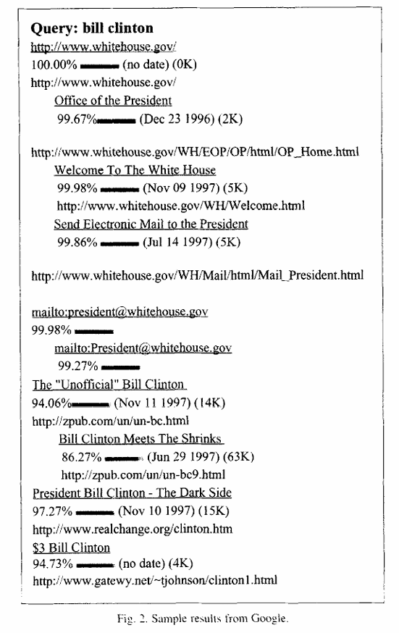
Cont…
Quality of Search Results
High Precision:
Use of PageRank, anchor text, and proximity information significantly improved search result relevance.
Example: A query for "Bill Clinton" returned high-quality results, including official pages from the White House.
Handling Complex Queries:
The system demonstrated an ability to cluster results and prioritize important pages.
For instance, documents with higher PageRank or closer term proximity appeared higher in the results.
Robustness:
None of the top results were broken links.
Results were clustered by server/domain for better user navigation.

Slide 20
Conclusions
Scalability:
The search engine was designed to handle rapid web growth, showcasing the ability to index and process millions of web pages efficiently.
Techniques like distributed crawling, optimized indexing, and compact data structures enabled scalability.
High-Quality Search Results:
The system successfully utilized innovative methods such as PageRank, anchor text, and proximity analysis to enhance result relevance.
It addressed common issues with low-quality results in existing search engines at the time, such as "junk results" or broken links.
Complete Architecture:
Google was established as a comprehensive system capable of:
Crawling web pages.
Indexing them efficiently.
Handling user queries and delivering high-quality search results.

Slide 21
Thank You!

